Slide 1
School Counselors: How We Can Help You
Alyssa Aysenne

Slide 2
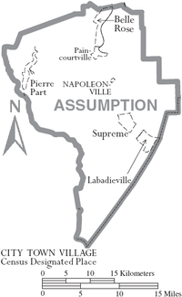
Goal of Our District
The goal of the Assumption Parish School District is to promote a learning environment that is safe and able to promote effective learning to produce life long learners who will become productive members of society.

Slide 3
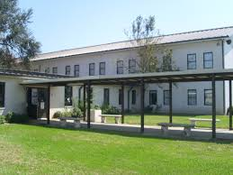
Goals of Our School
Academic
Academically, students will increase their performance on End-of-Course Exams.
Career
The goal of our school is to increase our overall graduation rate.
Personal/Social
The students enrolled at Assumption High School will increase their positive behavior.

Slide 4
Role of the School Counselor
American School Counselor Association (ASCA)
Louisiana School Counseling Model
focus on academic, career, and personal/social development of ALL students with the primary objective of promoting and enhancing student learning
My goal, as school counselor, is to help ALL of our students be academically successful!
I will participate as a member of the educational team and utilize the skills of leadership, advocacy, and collaboration to promote systemic change as appropriate.
Notes:
Our national organization, the American School Counselor Association (ASCA), as well as our state’s School Counseling Model emphasize that school counselors should focus on supporting academic, career, and personal/social development of ALL students. The primary goal of these efforts is to increase student learning, thus increasing academic achievement.
My goal is the same as yours – to help ALL of our students be academically successful!

Slide 5
What is my training?
Master’s in Curriculum and Instruction ( Nicholls State University 2009-2011)
Master’s in School Counseling (Lamar University)
Through Lamar University I have completed a 36 hour program that included:
Theories in Counseling
Counseling Skills
Human Growth & Development
Group Counseling
Social & Cultural Foundations in Counseling
Psychological Testing & Interpretation
Research in Counseling
Career Counseling
School Counseling Courses – MS and ASCA Model
Counseling Children/Behavioral Interventions, etc
160 hour practicum & internship
Notes:
Most people do not know the coursework that I have taken in order to be a school counselor. I am hoping through sharing this, that you will understand how my training can help you in the classroom.

Slide 6
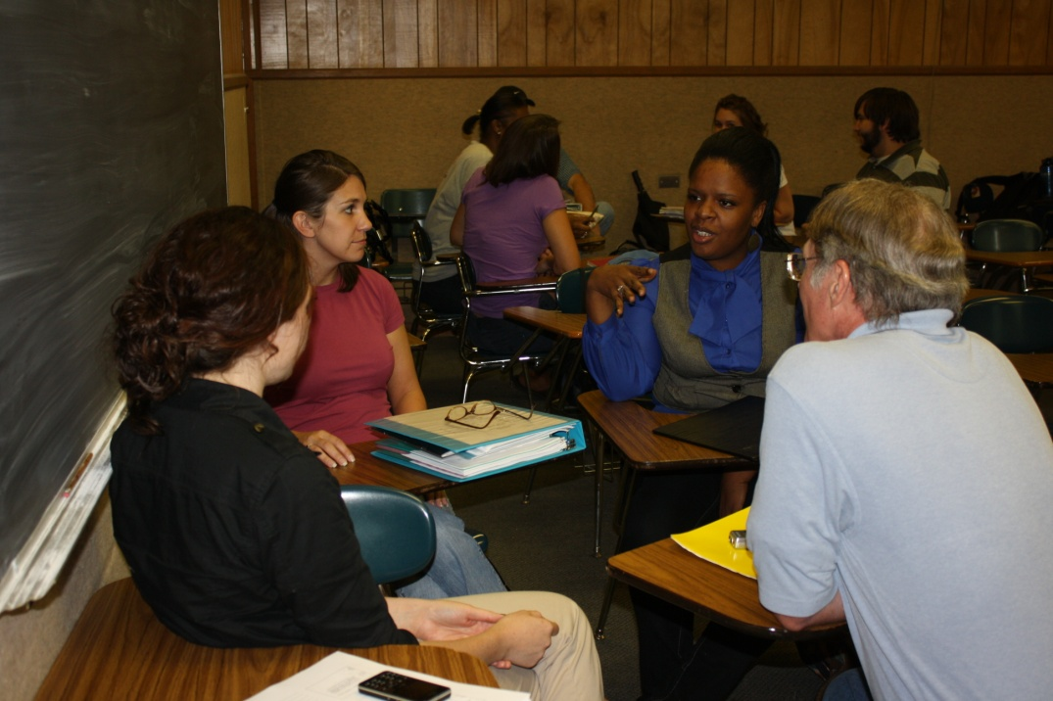
So how can the counseling department at assumption high school can help you?
Notes:
Use the photo above or insert your own photo of your staff working together!
So how can we help you? First, by being a team player with you. We are here to work with you to help the students succeed. None of us can do this job alone.

Slide 7
To promote Academics we provide:
Individual Counseling (at-risk students)
Group Counseling (at-risk students)
Classroom Guidance (prevention)
Parent/Teacher Workshops
Study skills
Test taking skills
Organizational skills
Creating a positive learning environment
Notes:
Academically, school counselors can work with students through individual counseling and small group counseling. The targeted students for these interventions would be those students that you have already identified as being at-risk of failure. In addition to working with these at-risk students, we can also provide classroom guidance lessons that focus on skills that all student need to help prevent academic failure and increase positive academic behaviors. Topics that we typically cover when working with students academically often include study skills, test taking skills, and organizational skills. Another service that we can provide is offering parent and teacher workshops. Many times parents struggle with helping their child academically, so we can offer workshops that focus on creating a positive learning environment for students at home and provide parents with strategies and tips to help their child be successful.

Slide 8
Academic resources:
http://www.westga.edu/studentDev/index_7704.php
This website provides students, educators, and parents with the resources to be academically successful by addressing academic issues such as memory techniques, stress management, study strategies, test taking skills, test anxiety, time management, and writing skills.
http://sas.calpoly.edu/asc/ssl/stressmanagement.html
This resource allows parents and students the opportunity to research how stress affects academic success. It identifies a strategy for modifying and identifying the causes of stress. It also provides a Skype number to provide counseling services to those students who are struggling academically due to lack of stress management skills.
http://www.depression-anxiety-stress-test.org/anxiety/online-anxiety-test.html
This interactive website allows students to complete an assessment to become aware of their level of test anxiety that is prohibiting their academic success.

Slide 9
To promoting Career Awareness we provide:
Individual Counseling
Group Counseling
Classroom Guidance
Louisiana Connect Website
Parent Workshops
Career Night
Financial Aid Night
College Awareness
School-Wide Events
Awareness
Interest inventories
College admissions
Career fair
Notes:
Counselors can also help our students focus on the end result of their K-12 education – finding a job! Through individual and group counseling, we can personally assist students who are struggling with their decisions regarding entering the workforce, college, police/fire academies, or military, determining their career interests, or obtaining a GED. We can help ALL students through offering Classroom Guidance lessons on the college admissions and financial aid process, as well as on general career awareness. Counselors can also help parents with understanding these dynamics as well through parent workshops. Finally, school-wide events can truly get all of the students involved by providing something like a Career Fair.

Slide 10
Career Resources:
https://www.careerzone.ny.gov/views/careerzone/index.jsf
This website provides students with the tools to explore careers and complete career assessments
www.louisianaconnect.org
This website provides Louisiana students and parents with the tool to keep current of graduation requirements, complete career inventories, research scholarships, and compare colleges
www.yourfreecareertest.com
This website provides students with a tool to complete career assessments to relate to interest, abilities, and skills
http://www.nod.org/disability_resources/.
This department provides individuals with disabilities the contact information for a variety of local work-related services, career development information, and also educational opportunities.
https://www.careerzone.ny.gov/views/careerzone/index.jsf
This resource allows students to research their career of interest.

Slide 11
To addressing Personal/Social Needs we provide:
Individual Counseling
Group Counseling based on assessments
Classroom Guidance based on needs assessments
Parent/Teacher Workshops
Address Diversity
Development
School-Wide Events
Anxiety, depression
Bullying, violence
Divorce, grief
Notes:
In our goal of increasing academic achievement among students, we sometimes lose sight of their personal/social needs. It is our firm belief that students will not be academically successful if their personal and social needs are being met. Many students struggle daily with a terrible home environment – many acting as the parent for the family. Many struggle with being bullied, feeling ostracized, or simply feeling like no one understands them. Many of our families are breaking down and our students are suffering. The counselors can help these students resolve their feelings related to these issues so that they can focus more on their academics while in your class.
Through individual and small group counseling, we can assist students who are desperately struggling with personal or social issues that are clearly interfering with their daily functioning. For ALL students, we can provide strategies for building resiliency skills, communicating positively with peers, parents, and teachers, as well as understanding the warning signs of more serious mental health conditions, such as depression and suicide. School-wide events can also bring attention to social issues that students may be experiencing, such as aggression, peer pressure, etc.
Addressing these personal and social concerns now, will help pave the way for improved academic behaviors in your classroom.

Slide 12
Personal/Social needs resources:
http://www.studygs.net/peermed.htm
This website addresses social developmental issues such as bullying, harassment, gossip, fighting, cheating, and relationship difficulties.
http://www.elementaryschoolcounseling.org/sg-anger-management.html
This website addresses how to assists students in coping with anger management to increase their social skills.
http://social-skills-lessons.com/social-skills-coaching/transitioning-to-adulthood/
This resource provides information on achieving social developmental goals such as understanding body language, mastering conversational skills, understanding the idea of personal space, learning friendship skills, and gaining assertiveness skills. These are vital skills to assisting in the transition between high school and college.

Slide 13
Comprehensive School Counseling Programs Provide:
Prevention Services
Classroom Guidance
School-Wide Events
Intervention Services
Individual Counseling
Group Counseling
Support Services
Parent Workshops
Teacher Workshops
Notes:
It is our desire as the school counseling program to implement a comprehensive school counseling program that focuses on helping our school meet the goals that we have set. We can do this through providing prevention, intervention, and support services.

Slide 14
Why is the Comprehensive School Counseling Program important for students:
Students who are enrolled in a school that possesses an effective comprehensive school counseling program experience the following as per recent studies:
Academically
Higher grades
Better prepared for future
Higher test scores
Reduction of classroom disturbances due to behavior
Career
Increased college attendance
Understanding the relevance of education
Personal/Social
Prevention of suicide
Decreased disciplinary concerns
Reduction of bullying and aggressive behaviors
Improvement of student/teacher and student/ parent relationships
Notes:
Why is a comprehensive school counseling program important? It helps our students.
Studies have shown that in schools where the counselor’s time is primarily focused on providing the services that we have discussed, that academically, students
- earn higher academic grades,
- are better prepared for the future,
- earn higher test scores,
- and notice a considerable reduction of classroom disturbances due to other’s inappropriate behavior.
Students understand the relevance of their K-12 education and more students attend college.
Studies have also shown that schools with a comprehensive school counseling program have demonstrated
- prevention of student suicide
- significantly decreased disciplinary referrals
- a reduction of bullying and other aggressive behaviors
- and an improvement in student/teacher/parent relationships.
If you have someone who wants to see the references, then go to this website:
http://www.counseling.org/PublicPolicy/TP/ResourcesForSchoolCounselors/CT2.aspx
This page has a ton of information related to studies that show our effectiveness as well as other resources that you might find beneficial!

Slide 15
Let’s Work Together
Louisiana School Counselor Performance Evaluation Rubric
Louisiana School Counseling Model
Bulletin 741

Slide 16
Let’s Work Together
Our school system is unique! Therefore, in our community a needs assessment is conducted periodically to ensure our services coordinate with the needs of the students in our community.
When planning the school counseling program, cultural beliefs, developmental differences, and individual needs are vital factors to determine how the program will be conducted.
By refocusing our efforts on helping our school and district meet our goals, the school counseling program looks forward to developing and implementing prevention, intervention, and support services designed for our school’s needs!

Slide 17
Action Plan
To reach our goals, I plan to meet with students individually at a minimum of two- one hour sessions. Furthermore, I plan to conducted classroom guidance lessons at least once a month as shown below and conduct group counseling sessions to ensure academic, personal, and career planning success based on student needs.
I also plan to ensure that parents are informed by having them participate in activities during school and after school.
Individual & Group Counseling
Topics discussed during these sessions include academic/career planning, skills including time management, test taking strategies, study strategies,
Classroom Guidance
Unit themes for classroom guidance include: Abuse, Academic Achievement/Success, Anger Management, Behavioral Issues, Career Development, Character Education, Diversity, Divorce, Dropout Prevention, Substance Abuse, and Suicide Prevention
Notes:
This year, I plan to focus on (describe goal here). I would like to implement the following services:

Slide 18
Action Plan
Teacher Workshop
Workshops on Diversity
Instructional Strategies
Parent Workshops
Academic Planning – provide parents with program requirements (Core 4, Basic Core, Career Diploma)
Career Planning
College Application Assistance
Scholarship Information
School-Wide Events
Career Night – families are exposed to potential career options
Financial Aid Night – families are provided resources on completing financial aid applications

Slide 19
Working together, we can all help our students be successful!

Slide 20
Developed with the help of…
Dr. Kimberly R. Hall, MCA Advocacy Co-Chair & Associate Professor
Jeri Lynn Rushing, MCA Advocacy Co-Chair & School Counselor
MSU Students in School Counseling:
Whitney Alford
Courtney Allen
Rachael Ammons
Beth Benson
Emily Cayson
Joe Evans
Reginald Gandy
Chaiqua Harris
Chris Johnston
Michael Keeton
MSU Students
Holly Morgan
Sarah O’Brien
Rachel Owens
Kelly Roberts
Brittany Rowe
Chelsey Rushing
Maria Schoen
Brittany Steer
Megan Stone
Chris Turner
Paul Young
Jessica Hubbard, School Counselor & 2013 MSCA President
Cherie Maynard, Administrator
Dr. Cheryl Justice, Assistant Professor

